Slide 1
24ADC001_BUSINESS INTELLIGENCE
PRIYA DHARSHINI R -24BAD092

Slide 2
Agenda
Introduction
Scenario
Datasets Used
NotebookLM Setup
Task 1 – Upload Sources
Task 2 – Region-wise Method Comparison
Task 3 – Comparison of MAPE & RMSE
Task 4 – Surprising Results
Task 5 – Simple Methods Performance
Task 6 – Regional Recommendations
Executive Summary
Critique of NotebookLM
Conclusion

Slide 3
Introduction
Lab Objective
The objective of this lab is to use NotebookLM to compare different forecasting methods across five regions and combine numerical forecasting accuracy with qualitative analyst notes.
Concepts Covered
Business forecasting model comparison
Data-driven reasoning
Logic-driven reasoning
AI-assisted synthesis
Interpretation of forecasting results

Slide 4
Scenario
Scenario
A national retailer tested six forecasting methods using five years of regional sales data.
The forecasting accuracy values were stored in one spreadsheet, while analyst comments describing regional demand patterns were stored separately.
Problem
The retailer needs to determine:
Which forecasting method should be used for each region?
NotebookLM is used to combine both sources and generate recommendations.

Slide 5
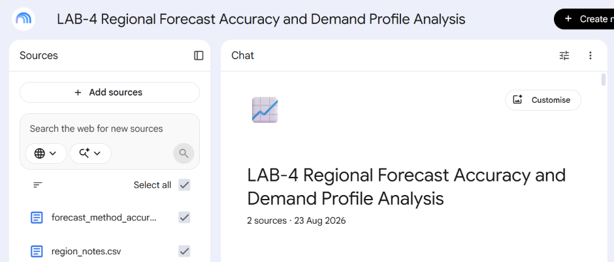
Datasets Used
Dataset 1: forecast_method_accuracy.csv
Contains:
Region
Forecasting method
MAPE percentage
RMSE
Method description
5 regions × 6 methods = 30 rows
Dataset 2: region_notes.csv
Contains:
Region
Analyst notes
Description of regional demand pattern

Slide 6
NotebookLM Setup
Steps Performed
Created a new NotebookLM notebook.
Uploaded forecast_method_accuracy.csv.
Uploaded region_notes.csv.
Used NotebookLM prompts to compare forecasting performance.
Analysed the generated results.
Generated recommendations for each region.

Slide 7
Task 1: Prepare the Sources
Sources Added
Source | Purpose
forecast_method_accuracy.csv | Compare forecasting accuracy
region_notes.csv | Understand regional demand patterns
Purpose
The two sources allow NotebookLM to connect:
Numerical accuracy + Business context

Slide 8
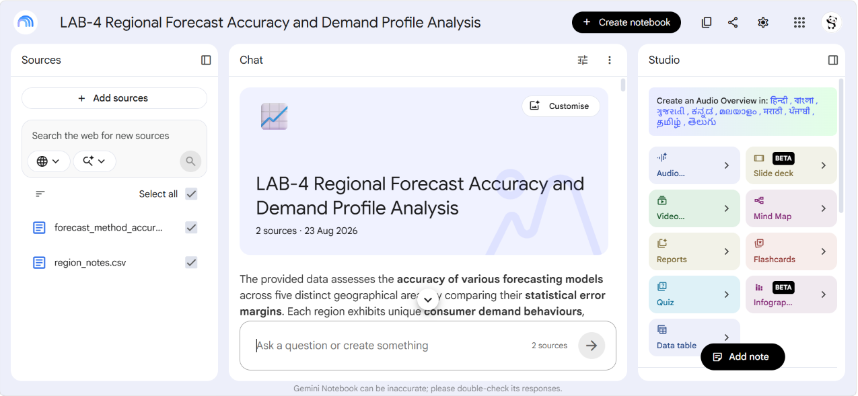

Slide 9
Task 2: Region-wise Forecasting Comparison
Prompt Used
“Which forecasting method performs best in each region, and does that match what the analyst notes say about each region's demand pattern? Compare the MAPE and RMSE values from forecast_method_accuracy.csv with the regional analyst notes from region_notes.csv.”
Result
Region | Best Method | MAPE | RMSE
North | Holt-Winters | 3.0% | 10.2
South | SES / SMA | 12.5% / 12.6% | 48.7 / 41.8
East | Holt-Winters | 11.6% | 44.6
West | Holt-Winters | 8.0% | 28.1
Central | Holt-Winters | 3.4% | 13.5

Slide 10
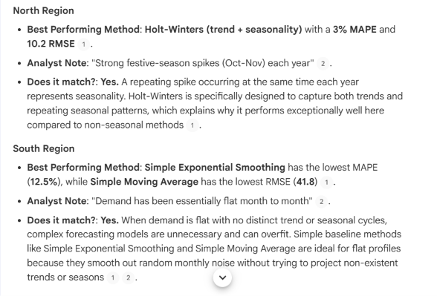
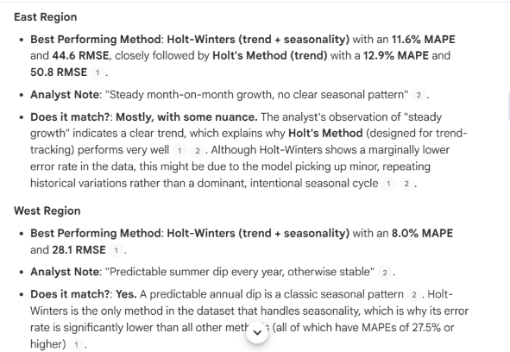

Slide 11
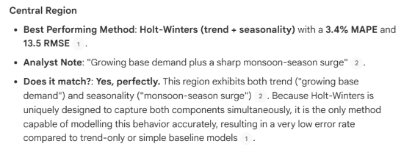

Slide 12
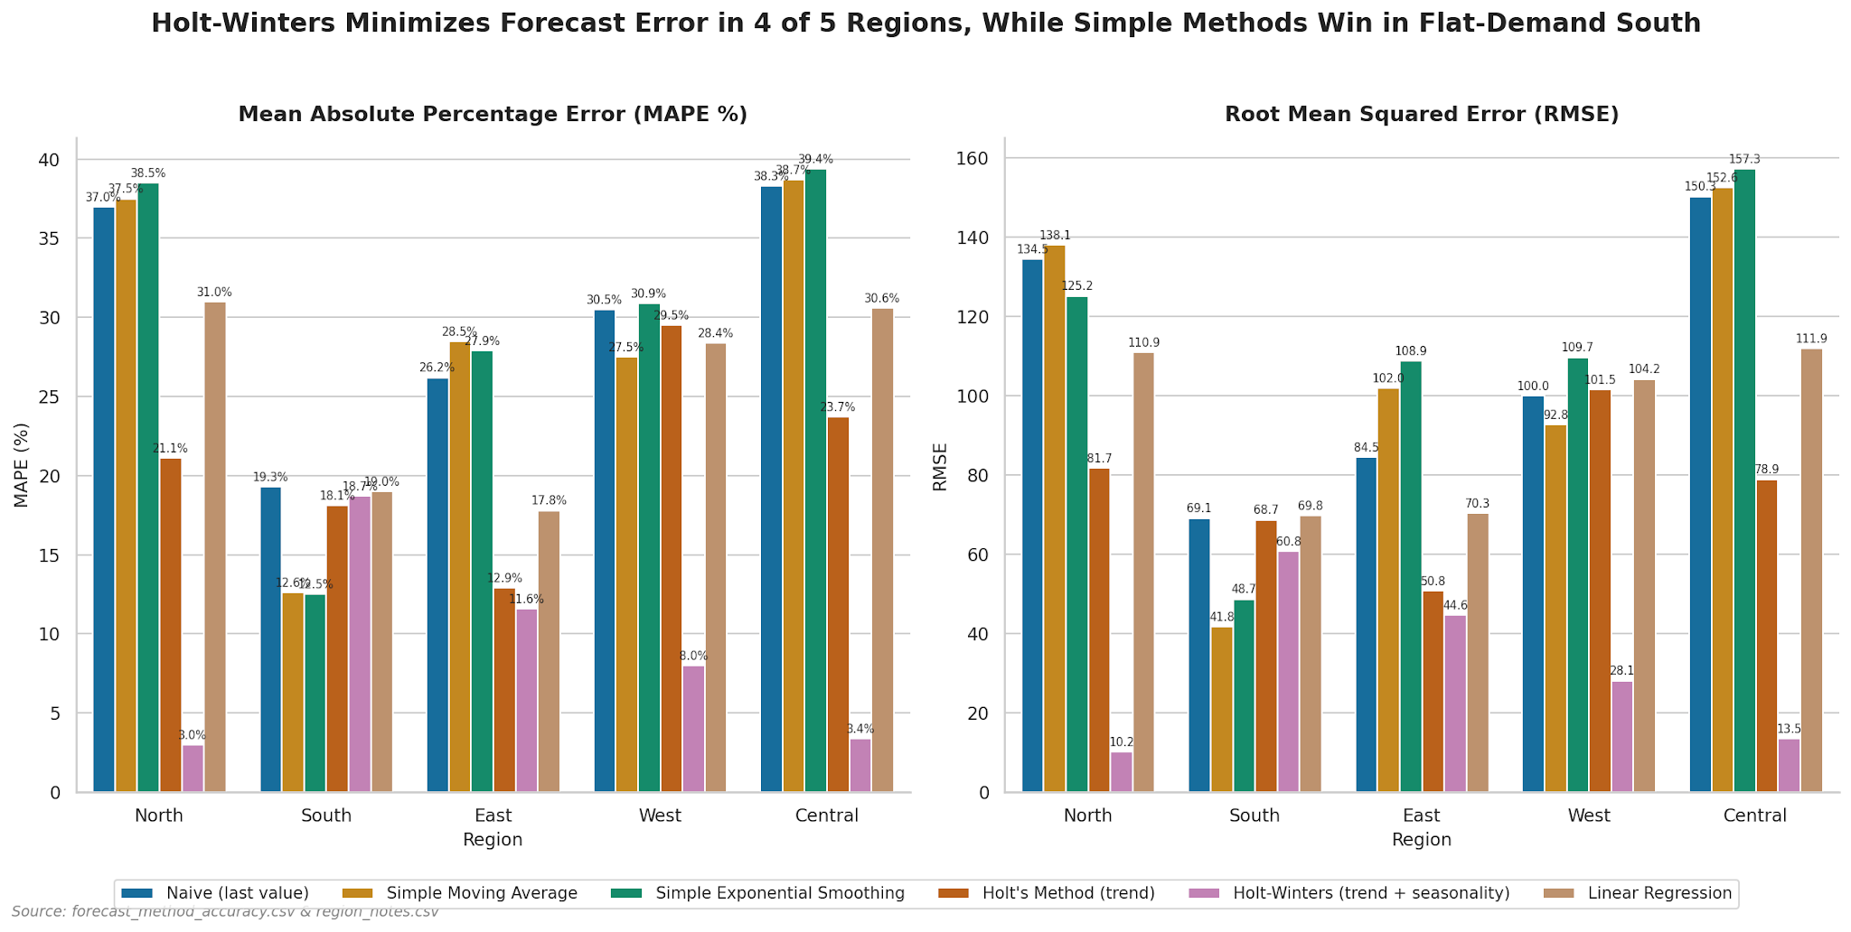
Task 3: MAPE & RMSE Comparison
What was compared?
Two accuracy measures were used:
MAPE
Measures percentage error.
Lower value = better forecasting accuracy.
RMSE
Measures prediction error.
Lower value = better performance.
Main Result
North → Holt-Winters
South → SES/SMA
East → Holt-Winters
West → Holt-Winters
Central → Holt-Winters

Slide 13
Task 4: Surprising Result
East Region
The East region is surprising.
Analyst Note
Steady month-on-month growth with no clear seasonal pattern.
Expected
Holt's Method
because it is designed to handle trends.
Actual Winner
Holt-Winters
MAPE = 11.6%
RMSE = 44.6
Holt's Method:
MAPE = 12.9%
RMSE = 50.8

Slide 14
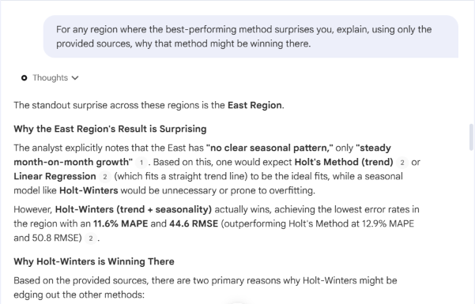
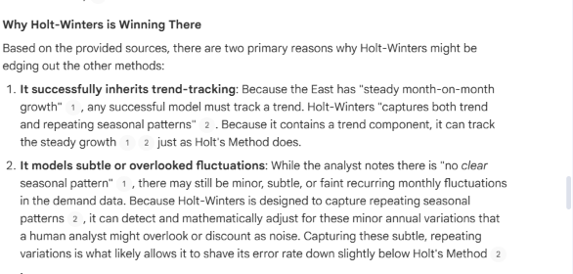

Slide 15
Task 5: Simple Methods
South Region
The South region is the best example where simple forecasting methods are competitive.
Method | MAPE | RMSE
SES | 12.5% | 48.7
SMA | 12.6% | 41.8
Naive | 19.3% | 69.1
Holt's | 18.1% | 68.7
Holt-Winters | 18.7% | 60.8
Linear Regression | 19.0% | 69.8
Why?
The analyst note says:
“Demand has been essentially flat month to month.”
Therefore, complex trend and seasonal models provide little benefit.

Slide 16
Task 6: Simple Methods Regional Recommendations
Recommended Forecasting Methods
Region | Recommendation | Reason
North | Holt-Winters | Festive spikes
Central | Holt-Winters | Growth + monsoon surge
West | Holt-Winters | Summer seasonal dip
East | Holt-Winters | Steady growth + subtle variations
South | SES / SMA | Flat and stable demand

Slide 17
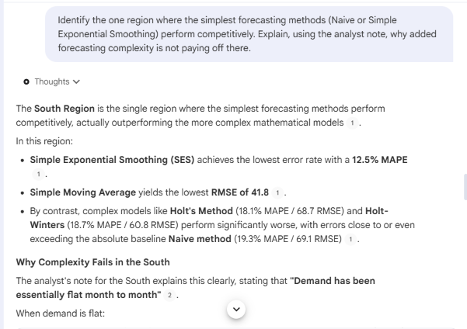
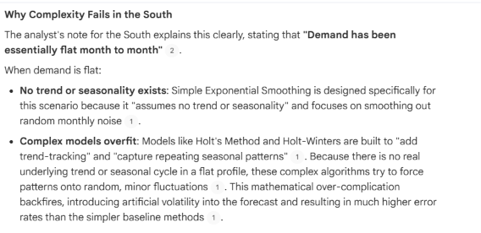

Slide 18
Regional Analysis
North
Holt-Winters
Festive spikes occur during October–November, indicating strong seasonality.
South
SES / SMA
Demand is flat, so simple models work effectively.
East
Holt-Winters
Steady growth exists, although there is no clear seasonal pattern.
West
Holt-Winters
Predictable summer dip indicates seasonality.
Central
Holt-Winters
Both growth and monsoon-season demand patterns exist.

Slide 19
Executive Summary
Final Recommendations
North → Holt-Winters MAPE: 3.0%, RMSE: 10.2
Central → Holt-Winters MAPE: 3.4%, RMSE: 13.5
West → Holt-Winters MAPE: 8.0%, RMSE: 28.1
East → Holt-Winters MAPE: 11.6%, RMSE: 44.6
South → SES / SMA MAPE: 12.5% / 12.6%

Slide 20
Key Takeaways
Key Findings
Different regions require different forecasting methods.
Holt-Winters performs best in North, East, West and Central.
Simple methods are effective for stable South-region demand.
Lower MAPE and RMSE indicate better forecasting accuracy.
NotebookLM can combine numerical data with qualitative analyst knowledge.
Forecasting model selection should be based on the demand pattern of each region.

Slide 21
Conclusion
NotebookLM successfully combined the forecasting accuracy data with regional analyst notes to produce region-specific forecasting recommendations.
The lab demonstrates that:
Data + Analyst Knowledge + AI Synthesis = Better Business Decision Support

Slide 22
Thank you!

